Slide 1
Unit 1 Further Development

Slide 2

Contents
I
Translation
II
Writing
Speaking
III
Resources for further study
IV

Slide 3
Part 1 Translation
Section I: Translation
Part 1 E-C Translation: techniques & practice
Part 2 C-E Translation: techniques & practice

Slide 4
1.1 E-C Translation Techniques & Practice
一、语态转换法
1.语态转换法：英译汉中，经常需要英语句子中的被动语态转换为汉语中的主动语态，从而符合汉语的使用习惯和表达。
2.语态转换原因分析：英语多用名词做主语，因此被动语态比较常见，且英语的被动语态表意是中性的，不带作者的主观感情色彩；而汉语属于动词强势的一种语言，一般由人做主语，因此句子当中以主动语态居多，在使用被动语态的时候往往多用于一些负面的场合，如“他被人打了；钱被他偷了；这话偏偏又被我听到了”。因此，在英译汉时要把握两种语言的区别和语态差异，选择合适的策略进行翻译。

Slide 5
1.1 E-C Translation Techniques & Practice
“语态转换法”技巧与实践
1.英语中的被动语态可以译为主动语态，如：
Much has been said about the necessity of introducing foreign funds into Chinese enterprises.
译文：有关中国企业引进外资的必要性已经谈的很多了

Slide 6
1.1 E-C Translation Techniques & Practice
“语态转换法”技巧与实践
2.英语中的被动语态还可以译诚汉语中的“由，受，遭到，靠，让，要，得到，得以，可以，加以”等结构：
If the stability can be maintained, one of the worst features of the cycle will have been removed.
译文：如果这种稳定状态得以保持下去，商业周期最坏的一个特征将得到消除。

Slide 7
1.1 E-C Translation Techniques & Practice
“语态转换法”技巧与实践
3.英语中的被动语态还可以译成汉语中的无主语，或者译成泛泛的主语：
You are required to return all the books you borrowed from the library by the end of this month.
译文：要求大家在月底前把从图书馆借的书全部归还。

Slide 8
1.1 E-C Translation Techniques & Practice
Translate the following paragraph with more attention to the use of “the change of voices” translation techniques.
In poetry, words are arranged in lines and stanzas rather than sentences and paragraphs. Lines and stanzas contribute to the visual element of a poem and enhance the reader’s overall experience by providing places to pause and rest stops to consider a change in subject matter. Another hallmark of poetry is that it uses few words to create high impact. Therefore, the poet chooses his words economically, using specific combinations of words and literary devices to produce vivid imagery and pack meaning into each line. Poems are often inspired by the poet’s own experiences and inspirations. The poet has discovered something profound and wants to relate it to others; therefore, poems are designed to provoke thought or cause an emotional response in the reader.

Slide 9
1.1 E-C Translation Techniques & Practice
Sample Answer:
在诗歌中，词是按照行和节排列的，而不是句子和段落。诗行和诗节有助于诗歌的视觉元素的形成，并通过提供暂停和空白来考虑主题的变化，增强读者的整体体验。诗歌的另一个特点是，它使用很少的文字来创造高影响力。因此，诗人在用词上讲究经济，运用特定的词语组合和文学手法，产生生动的意象，并将意义融入每一行。诗歌常常受到诗人自身经历和灵感的启发。诗人发现了一些深奥的东西，想把它与他人联系起来；因此，诗歌的目的是激发思想或引起读者的情感反应。

Slide 10
1.2 C-E Translation Techniques & Practice
二、无主句译法
无主句译法：汉语句子中主语隐含或无主语很常见，译成英文必须依照英语的要求，将主语增补进来。进行增补时要推敲语境，其次要考虑英语语法习惯和行文的需要。
无主句译法原因分析：在汉语中，只有谓语部分而没有柱与部分的句子叫做无主句。这里所谓的无主句，并不是省略了主语的句子，而是在汉语习惯上就这么讲，这么写。至于其主语到底是什么，往往很难确定，如“刮风了，要下雨了”。而一般而言，英语句子必须有主语，在组句子时，英语首先要确定主语，因为主语是位于讨论，描写和叙述的对象，因此在汉译英是确定主语是关键。

Slide 11
1.2 C-E Translation Techniques & Practice
无主句译法的技巧与实践
增补主语
汉语经常省略第一人称，在做汉语句子无主语英译时，可以适当的增补主语，如：we, they, you, things等：
不到长城非好汉。
译文：He who has never been to the Great Wall is not a true man.
一旦开始，就必须继续下去
译文：Once you begin, you must continue.

Slide 12
1.2 C-E Translation Techniques & Practice
无主句译法的技巧与实践
2. 使用形式主语“it”
在英语中，“it”通常用于天气、时间和其他一些自然现象。汉语中一些描述自然现象或时间的无主语句可以转换成以“it”为主语的英语句：
十点中了，他还没有回来
译文：It’s ten o’clock now, and he didn’t return home yet.

Slide 13
1.2 C-E Translation Techniques & Practice
无主句译法的技巧与实践
3. 翻译为英语被动句：
必须保证产品质量。
译文：The quality of product must be guaranteed.
没有爱心，就无法了解人生
译文：Life cannot be understood without much charity.

Slide 14
1.2 C-E Translation Techniques & Practice
无主句译法的技巧与实践
4. 翻译为英语“There be”结构
- 要发展就要变，不变就不会发展
译文：Development means change without change there can be no development.
- 不努力就不会成功
译文：There is no success without effort.

Slide 15
1.2 C-E Translation Techniques & Practice
无主句译法的技巧与实践
5. 翻译为英语祈使句
- 请大声点
译文：Louder, please.
- 不要去等待“合适的时间”，现在就行动！
译文：Don’t wait for the “right time”. Move now!

Slide 16
1.2 C-E Translation Techniques & Practice
无主句译法的技巧与实践
6. 翻译为英语倒装句：
- 随着一声吼叫，呼地从树林里窜出一只老虎来。
译文：Following the roar, out rushed a tiger from among the bushes.
- 然而，找不到任何迹象表明这两者之间存在着关系。
译文：Nowhere, however, are any indications found of those relationships holding between the two.

Slide 17
1.2 C-E Translation Techniques & Practice
Translate the following paragraph into English with more attention to the use of “subjectless sentence translation” techniques.
只有在大学你才可能意识到自我约束的重要性。适应大学生活往往需要几个月的时间,因此有必要学会自立。此外，你要制订一些可实现的目标，如读研。学习成绩对于你的未来关系很大。把尽可能多的时间用于学习的人最有可能成为尖子生。

Slide 18
1.2 C-E Translation Techniques & Practice
Sample Answer:
Only at college can you become aware of (realize / recognize) the importance of self-restraint. It usually takes a couple of months to adapt to (get accustomed to) college life, hence the need to (so it is necessary to / there is the need to) learn to be self-reliant. Moreover, you have to set some achievable goals, such as going on to graduate school (taking the entrance test for graduate schools). Academic performance (grades) can make much difference to your future. Those who spend as much time as possible on their study are most likely to be top students (excel).

Slide 19
Part 1 Translation
Section II: Writing
Well-organized Essay (好文章标准）

Slide 20
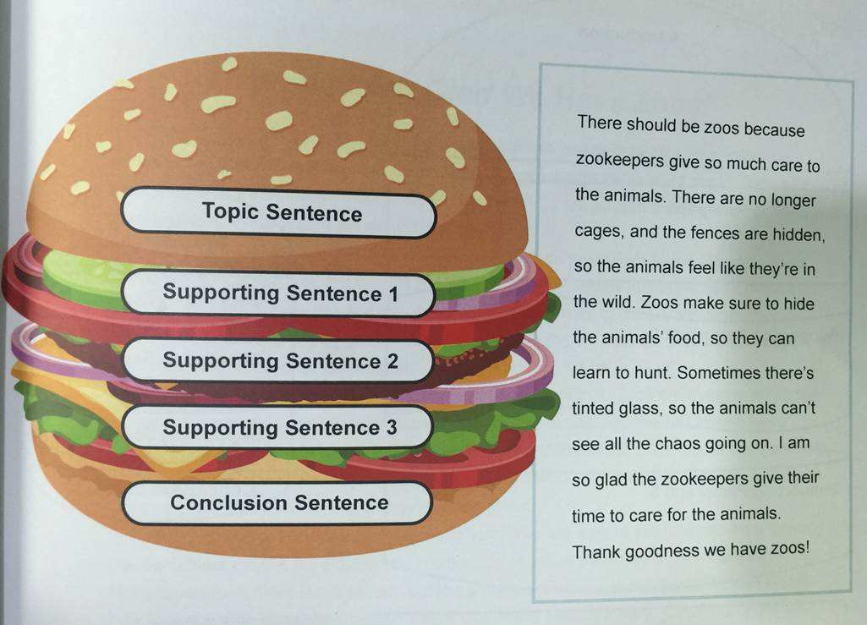
II. Writing Techniques — Well-organized Essay
Well-organized Essay
1. Analyze the well-organized essay from its structure
There are many different methods of writing, but the basic patterns used in standard writing are almost the same. Well-organized essays are usually taken in a form that echoes from beginning to end, also known as a "burger-shaped essay.“ Because the opening paragraph and the closing paragraph are very similar, the most important information is in the main body of the article. Think about what a hamburger looks like: the top and the bottom are the bread -- the beginning and the end, which wrap up the most important part of the burger.

Slide 21
II. Writing Techniques — Well-organized Essay
Well-organized Essay
1. Well-structured Essay
Writing procedures and techniques:
Introduction part:
a. Choose an appropriate topic.
b. Have a clear thesis statement
e.g. :Information technology has revolutionized the way we work.
c. Make an outline of the essay by following the “introduction - body – conclusion” structure.
d. Begin your essay by sentences that will easily attract your readers. You can use a quote; interesting or shocking numbers; a question; or a personal experience to start the essay.
e.g.: Home workers have grown from 150 thousand to 12 million in the past 5 years thanks to the wonders of the computer.
e. Give your thesis statement in the introduction part, and build the link between the introduction and body part.
e.g.: Technological innovation has thus made the traditional work place obsolete.

Slide 22
II. Writing Techniques — Well-organized Essay
Well-organized Essay
1. Well-structured Essay
Writing procedures and techniques:
B. Body :
Give a topic sentence for each paragraph in the body.
Use strong facts or examples to support the central point.
e.g.: When the Internet was first introduced, it was used primarily by scientists, now it is common in every classroom.
C. Conclusion:
Recap the major points in the previous part.
Restate the thesis statement.
Conclusion: Write the introduction, body and conclusion parts with integrity, unity and coherence, thus, you can present a well-structured essay.

Slide 23
II. Writing Techniques — Well-organized Essay
Well-organized Essay
2. Enrich your writing by choosing the
vocabulary and sentences patterns wisely.
Choosing vocabulary and sentence patterns wisely can enrich the writing and make the essay stand out. Here are some examples to learn from:
Present a viewpoint:
I am convinced that…
I completely approve of/ side with the former/ latter point of view
I can hardly share this viewpoint for the reasons below.
The issue of … is becoming a matter of concern
At present people are becoming increasingly aware of the importance of…
It is generally accepted/assumed/acknowledged that… , but…
Some people keep saying that… It is not entirely true/ so…

Slide 24
II. Writing Techniques — Well-organized Essay
2. Enrich your writing by choosing the
vocabulary and sentences patterns wisely.
B. Transitional sentences:
There are two instances in our daily life that can (best) verify/ prove this…
I would unfold the issue in three aspects.
There are three advantages to…
There are many reasons for this.
Admittedly, there are merits to both sides of the argument.
Before rendering my opinion, I think it is important to take a glance at the arguments on both sides.
It is crucial that we analyze the causes of this disturbing issue and explore effective solutions. From my own perspective, the causes are multiple.

Slide 25
II. Writing Techniques — Well-organized Essay
2. Enrich your writing by choosing the
vocabulary and sentences patterns wisely.
C. Topic sentence in the body :
The first reason that can be seen is that…
The main reason why… is that…
One of the most evident reasons is that…
Another factor that we must consider is that…
Another factor that should be taken into consideration is that…
It might also noted that…
Another reason why I agree with the above statement is that….
What is also worth noticing is that…
Perhaps another reason lies in the fact that…

Slide 26
II. Writing Techniques — Well-organized Essay
2. Enrich your writing by choosing the
vocabulary and sentences patterns wisely.
D. Present a different viewpoint:
We must admit that… However, it cannot be denied that…
As a matter of fact,… However, we also cannot deny that…
On this issue, some people hold a different attitude, arguing that…
On the other hand, some people strongly despise the above attitude. In their view…
On the other hand, there are many opponents who strongly argue that… However, further analysis would make it clear that…

Slide 27
II. Writing Techniques — Well-organized Essay
2. Enrich your writing by choosing the
vocabulary and sentences patterns wisely.
E. Draw a conclusion:
From what has been discussed above/we may draw/reach/come to/arrive at the conclusion that….
All the analysis/ evidence points to an unshakable/ sound conclusion that…
It is hoped that great efforts should be directed to / focused on finding/ improving…
From the facts mentioned above, it is safe to state that…
For the reasons given above, I strongly recommend/ believe that…
The following suggestions should be taken into consideration when we are seeking solutions to the problem.
In view of the seriousness of this problem, effective measures must be taken before things wet worse.

Slide 28
II. Writing Techniques — Exemplification
Effective Examples
Read the sample essay, analyze the structure of it and find out the thesis statement and topic sentences.
Sample Essay
Some companies attach equal importance to both social skills and academic qualifications when hiring new employees. In my opinion, education is the main prerequisite for achieving a successful career in this knowledge-intensive world.
First, higher education provides the basis for accessing top companies. It is not difficult to understand that job seekers must spend considerable amounts of time, money and energy to obtain their professional qualifications. This is why most employers value academic qualifications, as such eligibility means applicants have mastered more precise and professional knowledge. Without this competence, no opportunity could be acquired to enter the interview level. Second, after they are employed, expertise obtained from alma mater can make them work more efficiently. For example (give examples to support topic sentence), once a candidate from a normal college becomes a teacher, solid foundations like teaching methods and educational psychology help him easily adapt to the workplace.
( to be continued)

Slide 29
II. Writing Techniques — Exemplification
Effective Examples
Read the sample essay, analyze the structure of it and underline the thesis statement and topic sentences.
Sample Essay
Nonetheless, I also have to insist that social skills do play a very important role in one’s career success, some interior designers with great interpersonal skills can accurately figure out what their customers like in their future home, including stylistic preferences, color matching and decorations. Furthermore, such tendency can hardly be learned by attending academic institutions. In addition, teamwork is indispensable during one’s career. Due to globalization, many successful cases are achieved because of cooperation. Hence, better social skills add positive opportunities and great possibilities for most individuals’ success.
In conclusion, academic qualifications and social skills are essential for a bright career. However, in terms of importance, the former is more vital than the latter considering the competitiveness in the labor force.

Slide 30
II. Writing Techniques — Exemplification
Writing Tasks
Please write a short essay by following the direction, and make sure your essay is well-organized.
Writing directions:
Some people think schools should teach students to form good behavior in addition to providing formal education. To what extent do you agree or disagree? Write a short essay around 250 words.

Slide 31
Part 1 Translation
Section III: Speaking

Slide 32
III. Speaking
Deliver a 3-muniute public speech on one of the following tasks. You are supposed to give a clear explanation to your standpoint and preferably justify your supporting points with examples.
Do you think words have the power to change our lives?
2. Do you think the use of Internet slang（网络用语）has undermined the power of words？

Slide 33
III. Speaking
Do you think words have the power to change our lives?
Tips:
I do believe words have the power to change our lives, for words and language can shape our experiences.
Our everyday communications have the power to uphold social inequities as well as the power to disrupt them.
Words can shape how we perceive the world around us, where we direct our interests and, even might influence the direction our lives take. The mind can be easily influenced by the choice of words.
When you talk to others, the different words you choose to convey the same meaning may please or offend the listeners. Therefore, we should be aware of this power, and learn to choose the appropriate words in our daily lives.

Slide 34
III. Speaking
2. Do you think the use of Internet slang（网络用语）has undermined the power of words？
Tips:
I don’t think the use of Internet slang has undermined the power of words, instead it shows and even enhances the power of words.
The Internet slang terms, such as “LOL” (laughing out loud) has been added to the Oxford English Dictionary.
With the development of the Internet and mobile technology, the way people communicate and interact with each other is also changed and evolved.
The use of Internet slang is an unstoppable trend. By using these words, people may have a sense of belonging to a particular community online where they cannot possess in real life.

Slide 35
Part 1 Translation
Section IV: Resources for Further Study

Slide 36
IV. Resources For Further Study
Ted Talks
www.ted.com
David Peterson: Why language is humanity's greatest invention
Lera Boroditsky: How language shapes the way we think
Daniel Bögre Udell: How to save a language from extinction
Anne Curzan: What makes a word "real"?
Lýdia Machová: The secrets of learning a new language
Stephen Burt: Why people need poetry
Cristina Domenech: Poetry that frees the soul
Jorge Drexler: Poetry, music and identity

Slide 37
IV. Resources For Further Study
Books
John Langan, College Writing Skills with Readings (9th Edition) , The McGraw-Hill Companies, 2014
Lurie G. Kirszner, Stephen R. Mandell, The Wadsworth Handbook（8th Edition），Thomson Wadsworth, 2008

Slide 38
Thank You!
www.themegallery.com

